Slide 1

Where Is the Job Market Headed for Business Graduates?
Key Insights from LinkedIn Data
Dipita Dia Biswas
Simon Business School, University of Rochester

Slide 2



Data Set Description
26,519
Job postings
2023-2024
Dimensions:
Job Title
Company Name
Industry
Experience Level
Salary
Skills Required
Location

Slide 3
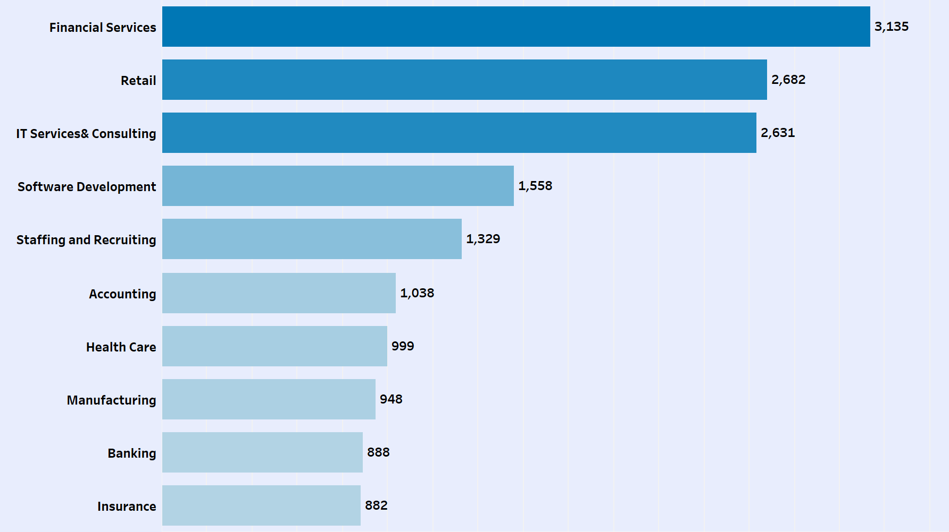
Financial Services, Retail, and IT Comprise nearly 32% of Job Postings

Slide 4
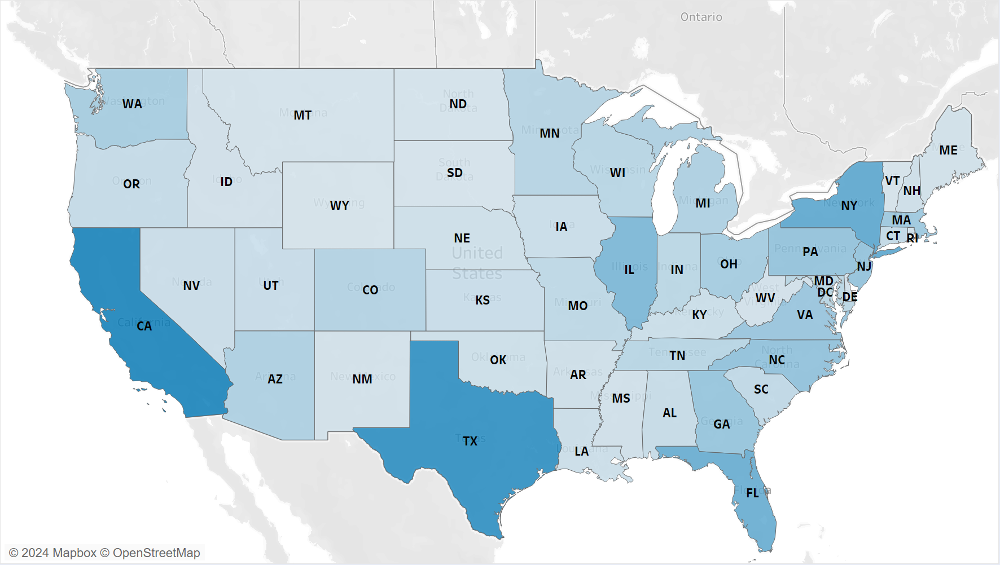
California, Texas, and New York Lead in Job Postings
1,573
1,177
2,683
2,321
1,422

Slide 5
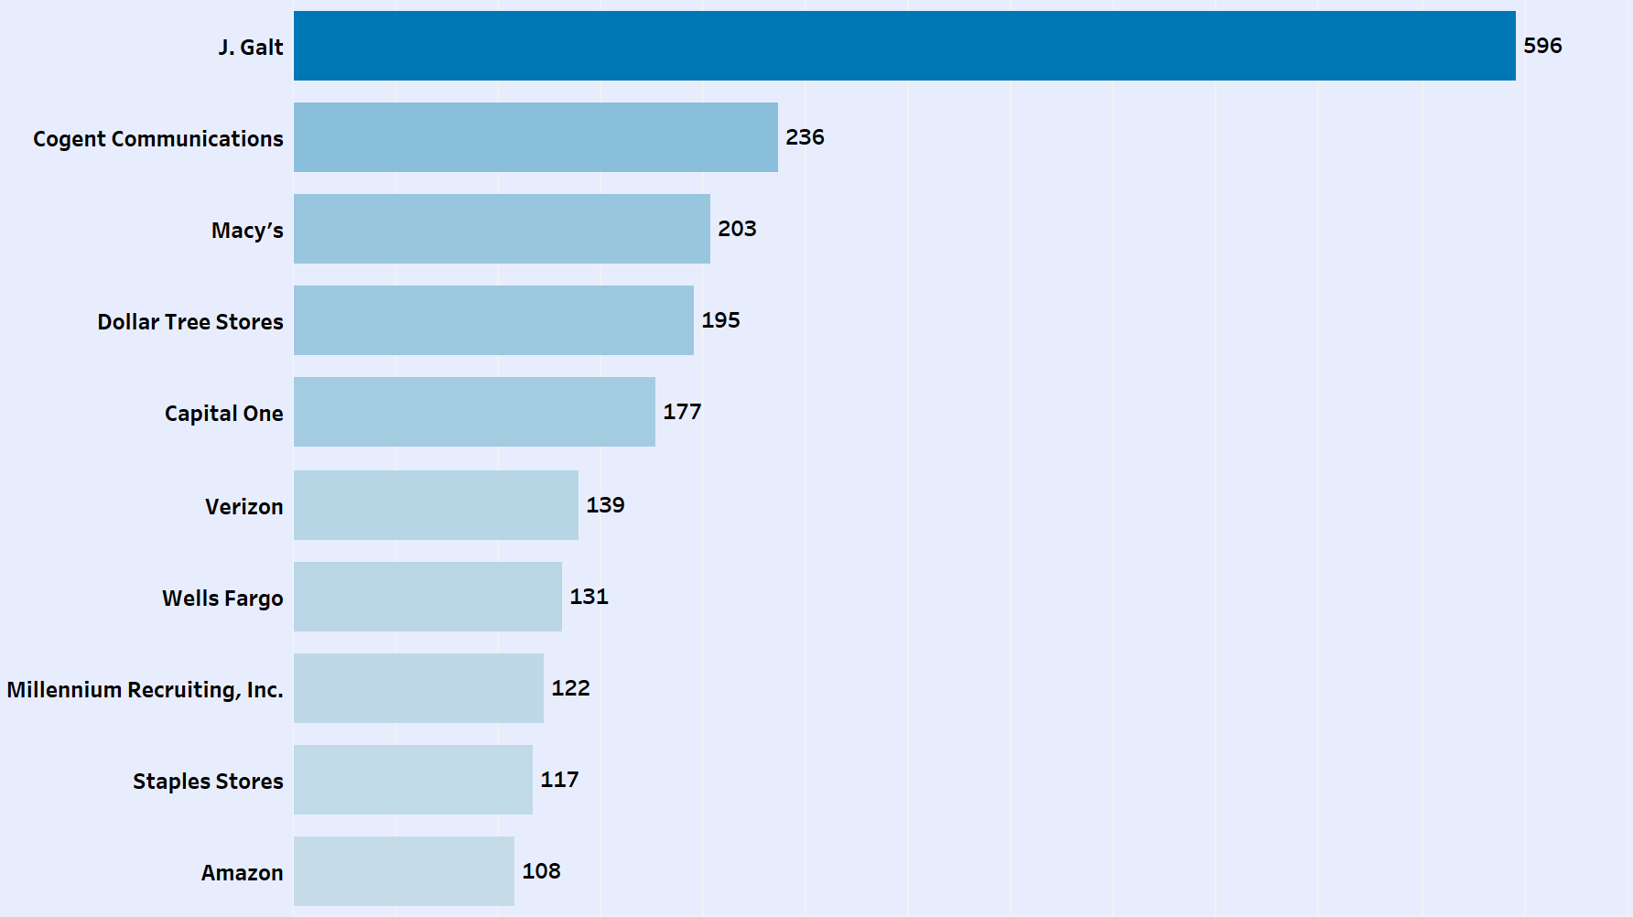
J. Galt’s Dominance, Lower Hiring by Well-Known Companies, and Amazon’s Reduced Job Posts

Slide 6
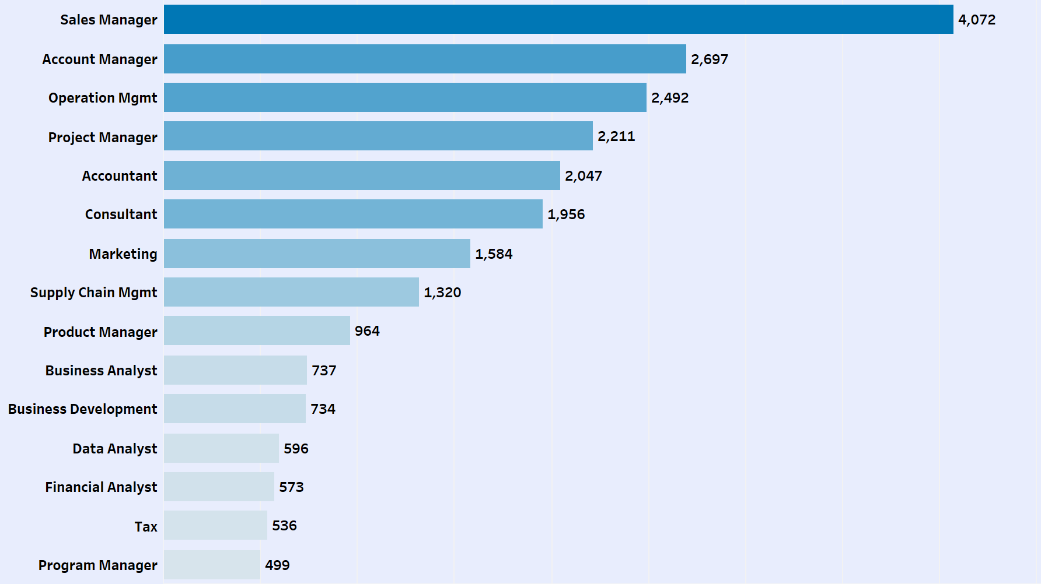
24.2% of Jobs Appeal to Business Analytics Graduates
24.2%

Slide 7
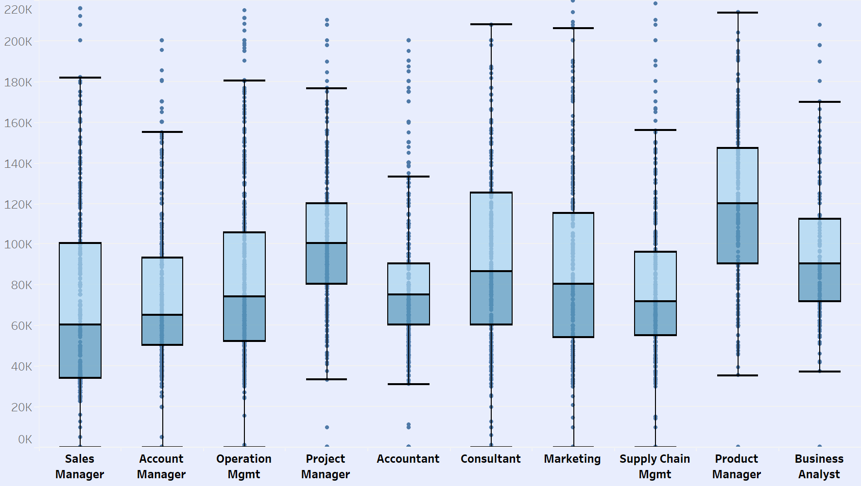
Top Jobs for Analytics Graduates Offer Median Salaries above Market Level
80K

Slide 8
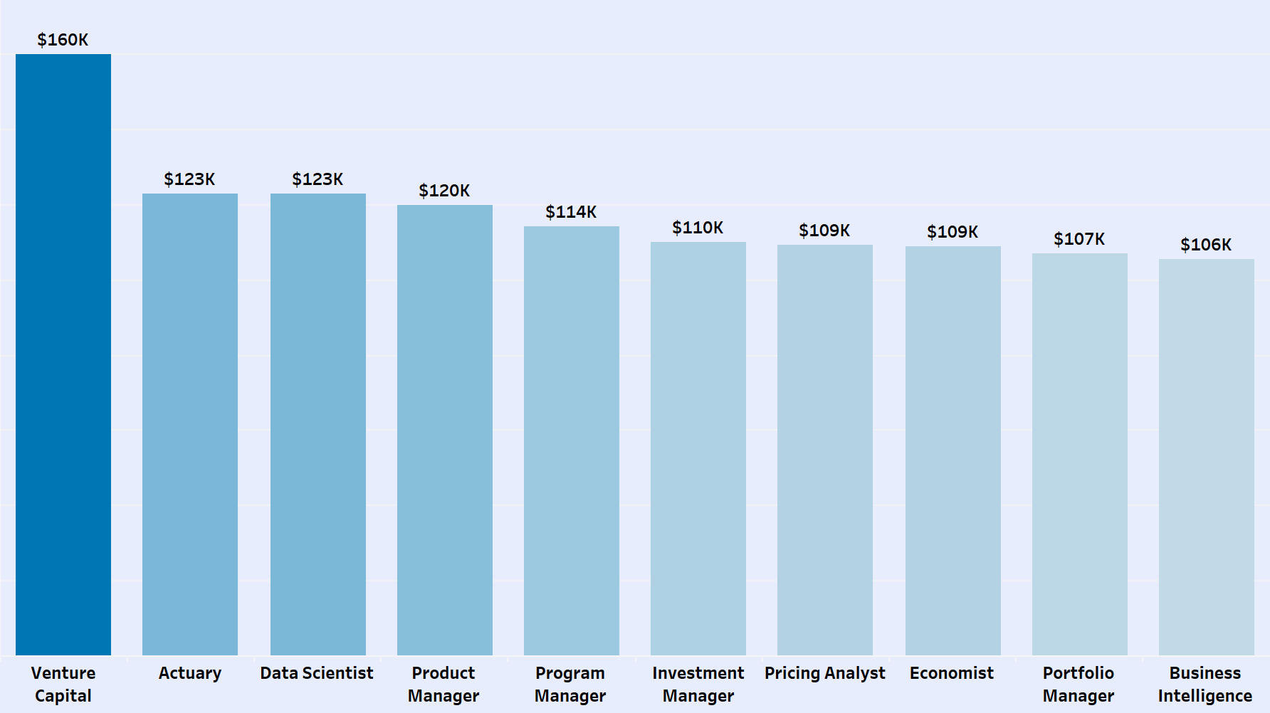
Venture Capital Tops High-Paying Roles with $160K Salary

Slide 9
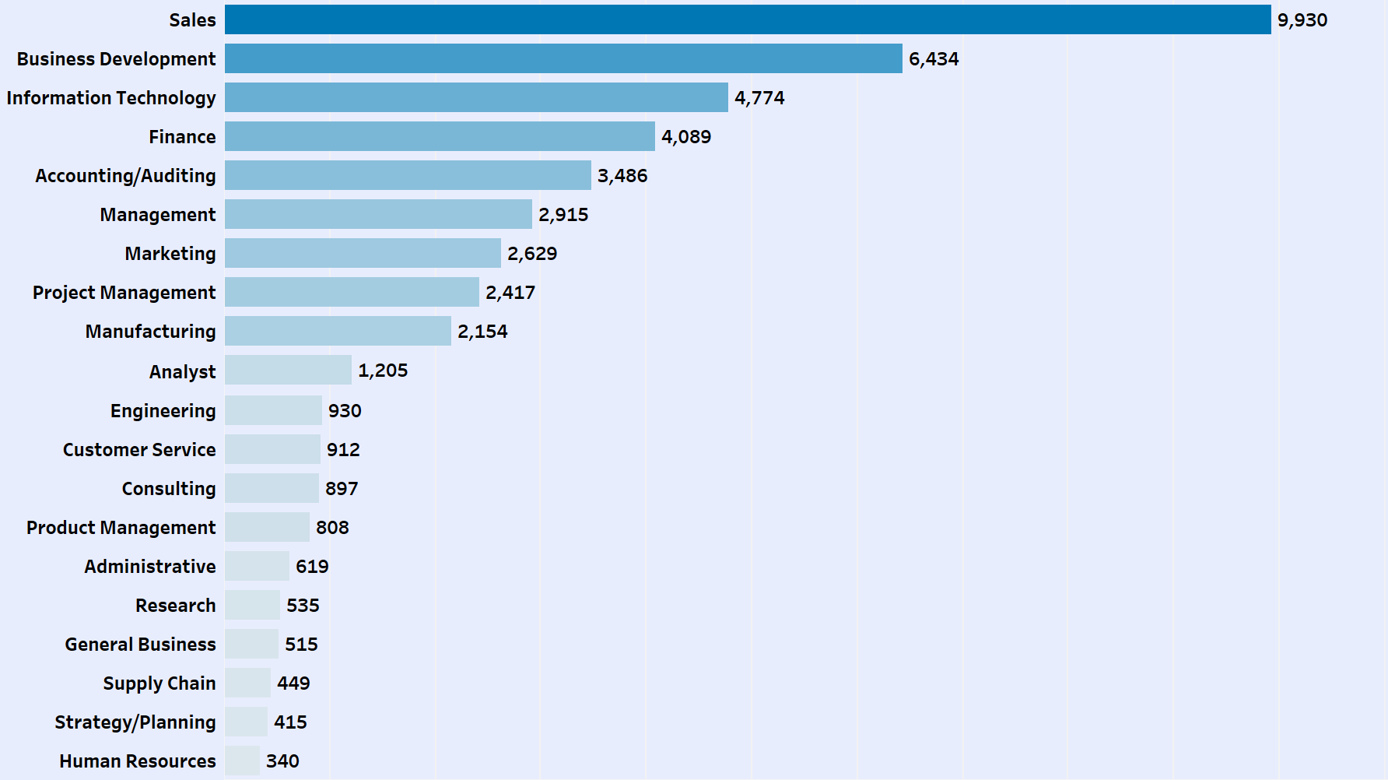
23% of the Jobs Demand Analytical and IT Skills
23%

Slide 10
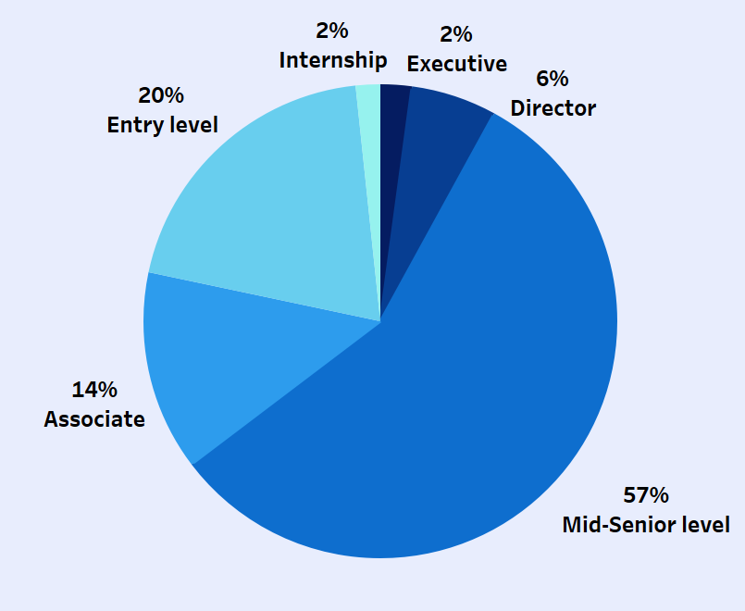
Entry-Level, Internship & Associate Roles Make Up 36% of Job Market

Slide 11
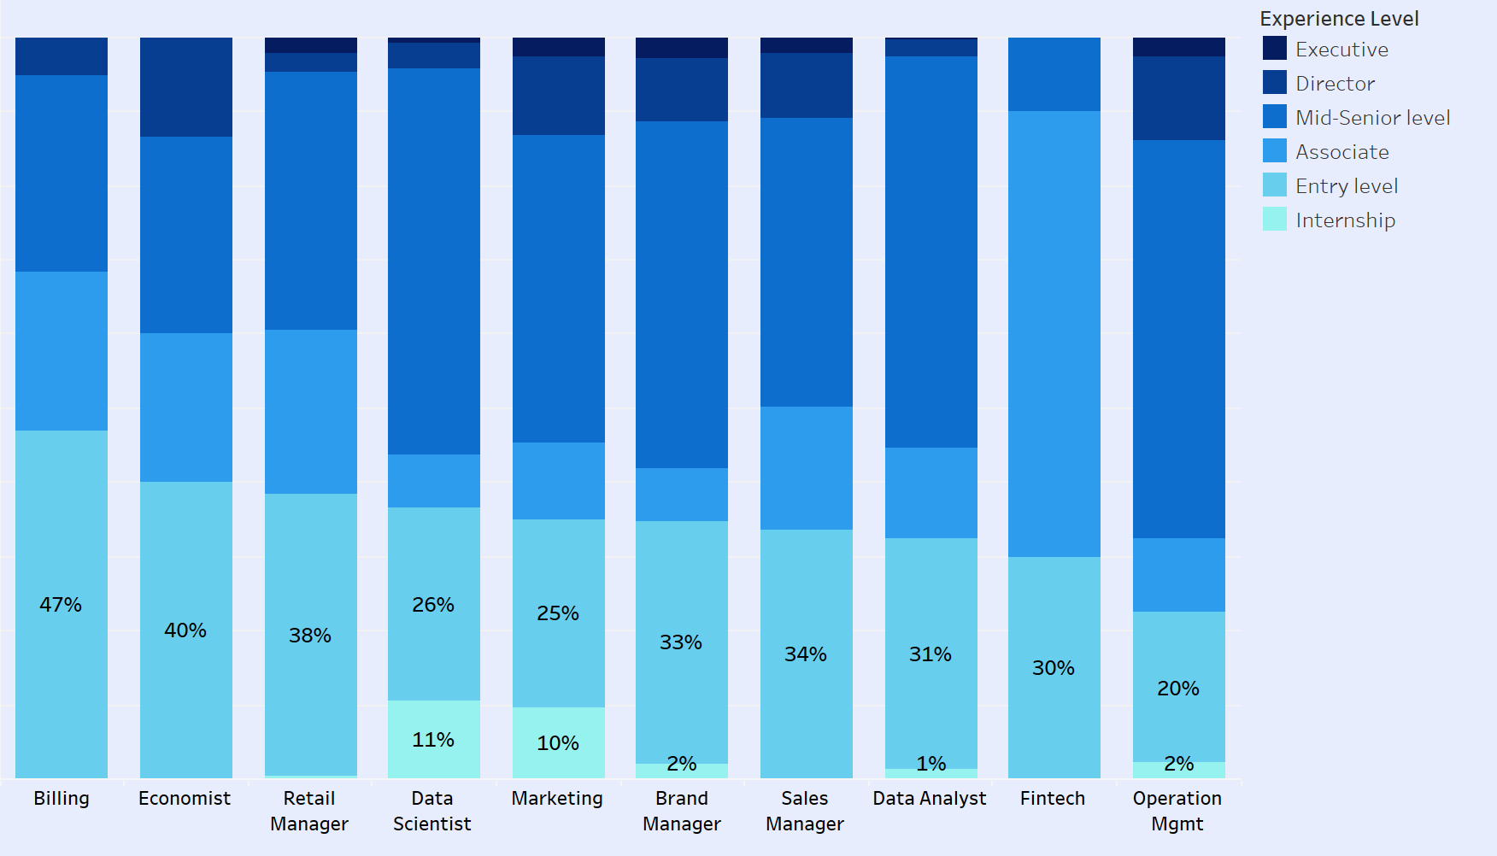
High Entry-Level Proportion For Data Scientist, Data Analyst and Marketing
37%
32%

Slide 12




Competitive Market for Business Analytics Graduates
24.2%
2,310 Jobs
26,519
Job postings
Jobs Appeal to Business Analytics Graduates
Entry level Jobs

Slide 13
Where Is the Job Market Headed for Business Graduates?
Key Insights from LinkedIn Data
Dipita Dia Biswas (dbiswas3@simon.rochester.edu)
Simon Business School, University of Rochester

